Slide 1
INTRODUCTION TO COMPUTING
Course Code: CCINCOM/L
More on Data, Sampling Techniques
Elizer Ponio Jr.
Faculty
Department of Computer Science
College of Computing and Information Technologies (CCIT)
National University
Joseph Marvin R. Imperial
QUANTITATIVE METHODS
NU College of Computing and Information Technologies
Course Code: CCQUAMET

Slide 2
Data
Data are facts, statistics, and figures from which conclusions or references can be drawn. Such conclusions are important to the decision making of many professions and organizations.
For example, economists use conclusions drawn from the latest data on unemployment and inflation to help the government make policy decisions.
Accountants use sample data concerning a company’s actual sales revenues to assess whether the company’s claimed sales revenues are valid.
Together, the data that are collected for a particular study are referred to as a data set.
Joseph Marvin R. Imperial
QUANTITATIVE METHODS
NU College of Computing and Information Technologies
Course Code: CCQUAMET

Slide 3
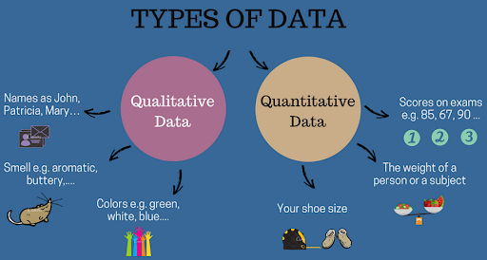
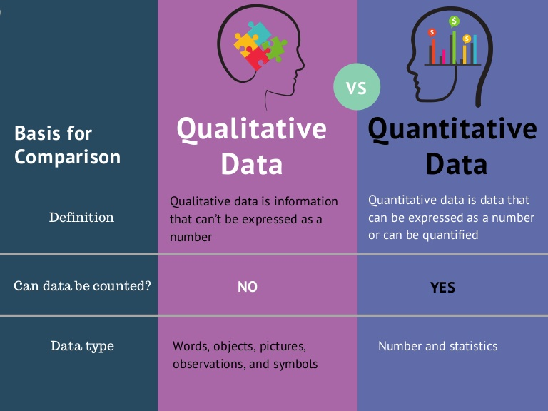
Types of Data
Joseph Marvin R. Imperial
QUANTITATIVE METHODS
NU College of Computing and Information Technologies
Course Code: CCQUAMET

Slide 4
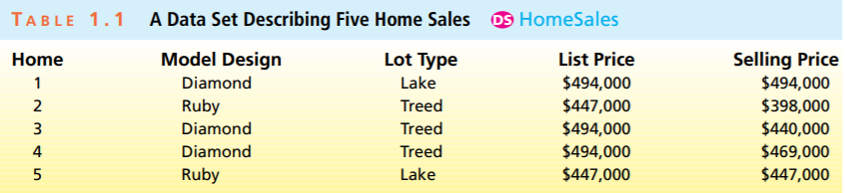
Data
Any dataset provides information about some group of individual elements, which may be people, objects, events, or other entities.
The information that a data set provides about its elements usually describes one or more characteristics of these elements.
Any characteristic or feature of an element is called a variable.
Joseph Marvin R. Imperial
QUANTITATIVE METHODS
NU College of Computing and Information Technologies
Course Code: CCQUAMET

Slide 5
Variables
If the possible measurements of the values of a variable are numbers that represent quantities, then the variable is said to be quantitative.
For example, the actual selling price of a home, the payment time of a bill, and the gasoline mileage of a car are all quantitative.
However, if we simply record into which of several categories an element falls, then the variable is said to be qualitative or categorical.
Examples of categorical variables include (1) a person’s gender, (2) the make of an automobile, (3) whether a person who purchases a product is satisfied with the product, and (4) the type of lot on which a home is built.
Joseph Marvin R. Imperial
QUANTITATIVE METHODS
NU College of Computing and Information Technologies
Course Code: CCQUAMET

Slide 6
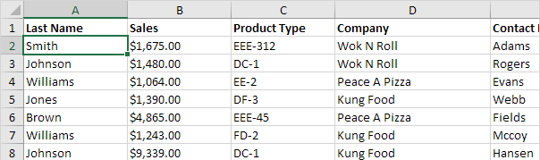
Which variables are qualitative and quantitative?
Joseph Marvin R. Imperial
QUANTITATIVE METHODS
NU College of Computing and Information Technologies
Course Code: CCQUAMET

Slide 7
Types of Data
Nominal
Ordinal
Cardinal
Joseph Marvin R. Imperial
QUANTITATIVE METHODS
NU College of Computing and Information Technologies
Course Code: CCQUAMET

Slide 8
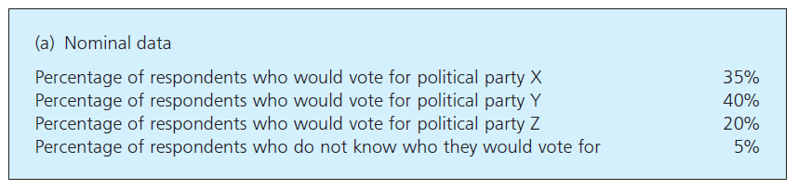
Nominal Data
kind that we really cannot quantify with any meaningful units.
simply describes something ex. “A car is blue”, “Republican”, “Male”
also called categorical or descriptive data.
The usual analysis for nominal data is to define a number of distinct categories and say how many observations fall into each.
Joseph Marvin R. Imperial
QUANTITATIVE METHODS
NU College of Computing and Information Technologies
Course Code: CCQUAMET

Slide 9
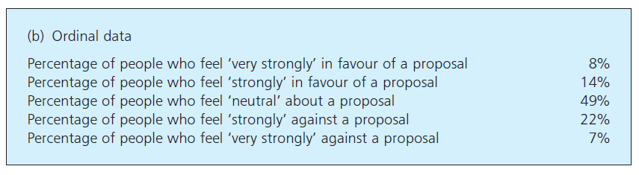
Ordinal Data
From the root word order. Here we can rank the categories of observations into some meaningful order.
The order of categories is important because we know that ‘medium’ comes between ‘large’ and ‘small’.
The key point is that the order of the categories is important, which is why ordinal data is sometimes described as ordered or ranked.
Joseph Marvin R. Imperial
QUANTITATIVE METHODS
NU College of Computing and Information Technologies
Course Code: CCQUAMET

Slide 10
Ordinal Data
From the root word order. Here we can rank the categories of observations into some meaningful order.
The order of categories is important because we know that ‘medium’ comes between ‘large’ and ‘small’.
The key point is that the order of the categories is important, which is why ordinal data is sometimes described as ordered or ranked.
Joseph Marvin R. Imperial
QUANTITATIVE METHODS
NU College of Computing and Information Technologies
Course Code: CCQUAMET

Slide 11
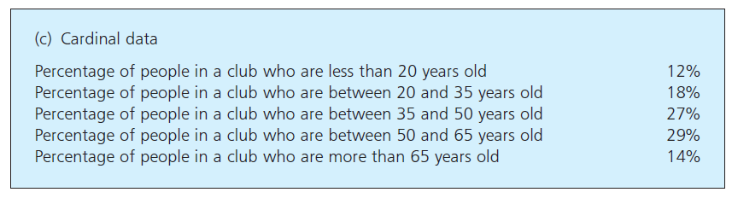
Cardinal Data
has some attribute that can be measured directly.
For example, we can weigh a sack of potatoes, measure the time taken to finish a job, find the temperature in an office, and record the time of deliveries.
These measures give a precise description, and are clearly the most relevant to quantitative methods.
Joseph Marvin R. Imperial
QUANTITATIVE METHODS
NU College of Computing and Information Technologies
Course Code: CCQUAMET

Slide 12
Cardinal Data
We can divide cardinal data into two types depending on whether it is discrete or continuous.
Discrete data - if it takes only integer values. The number of children in a family is discrete data, as are the numbers of cars owned, machines operated, shops opened and people employed.
Continuous data - can take any value and is not restricted to integers. The weight of a packet of biscuits is continuous, and can take values like 256.312 grams – as are the time taken to serve a customer, the volume of oil delivered, the area covered in carpet and the length of a pipeline.
Joseph Marvin R. Imperial
QUANTITATIVE METHODS
NU College of Computing and Information Technologies
Course Code: CCQUAMET

Slide 13
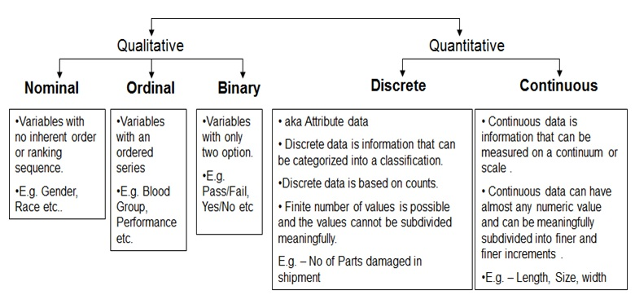
Joseph Marvin R. Imperial
QUANTITATIVE METHODS
NU College of Computing and Information Technologies
Course Code: CCQUAMET

Slide 14
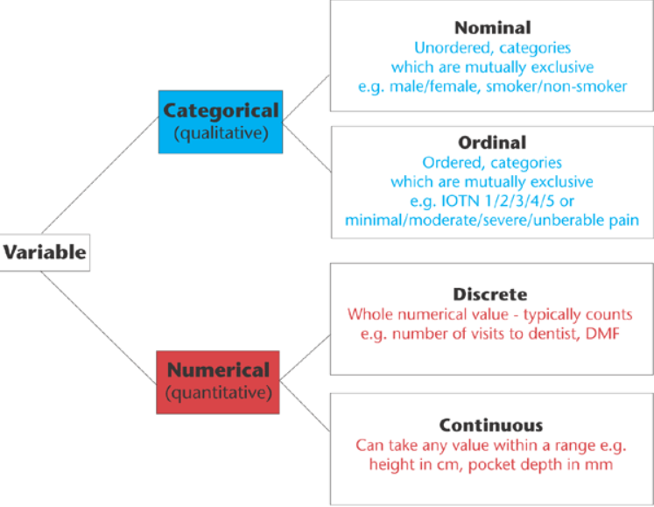
Joseph Marvin R. Imperial
QUANTITATIVE METHODS
NU College of Computing and Information Technologies
Course Code: CCQUAMET

Slide 15
Population
A population is the set of all elements about which we wish to draw conclusions.
Example: (a) all of last year’s graduates of National University Business Administration program, (b) all current MasterCard cardholders, and (c) all university students of the Philippines.
Here we are using population in the statistical sense of all people or entities that share some common characteristic.
When you can get a complete list of a population, you have a sampling frame (source). Some common sources of sampling frames include electoral registers, memberships of organizations, lists of employees, website addresses and credit rating agencies.
Joseph Marvin R. Imperial
QUANTITATIVE METHODS
NU College of Computing and Information Technologies
Course Code: CCQUAMET

Slide 16
Population
We usually focus on studying one or more variables describing the population elements.
If we carry out a measurement to assign a value of a variable to each and every population element, we have a population of measurements (sometimes called observations).
If the population is small, it is reasonable to do this. For instance, if 150 students graduated last year from the National University BA program, it might be feasible to survey the graduates and to record all of their starting salaries.
Joseph Marvin R. Imperial
QUANTITATIVE METHODS
NU College of Computing and Information Technologies
Course Code: CCQUAMET

Slide 17
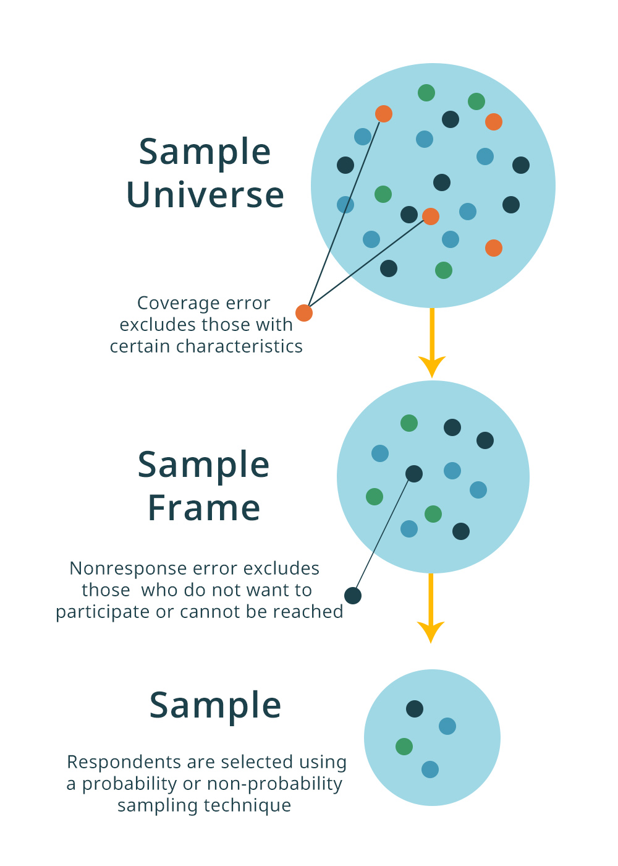
Joseph Marvin R. Imperial
QUANTITATIVE METHODS
NU College of Computing and Information Technologies
Course Code: CCQUAMET

Slide 18
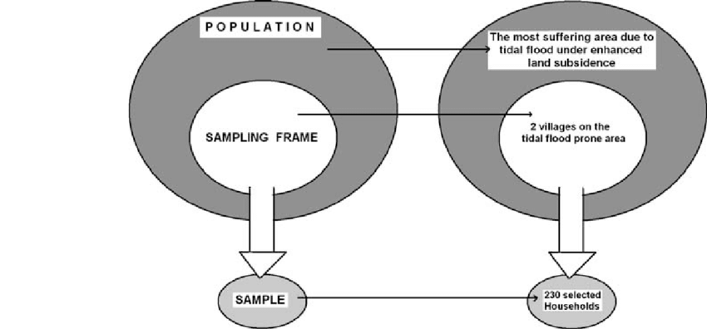
Joseph Marvin R. Imperial
QUANTITATIVE METHODS
NU College of Computing and Information Technologies
Course Code: CCQUAMET

Slide 19
Population
Census - collecting data from every entry in the sampling frame – which is the whole population. A census clearly gives the most accurate results – but it is never completely accurate because there are inevitably errors, misunderstandings and omissions. So a census is difficult, time-consuming, and expensive. In such a situation, we select and analyze a subset (or portion) of the population elements.
Sample - collecting data from only a representative sample of entries in the sampling frame.
Joseph Marvin R. Imperial
QUANTITATIVE METHODS
NU College of Computing and Information Technologies
Course Code: CCQUAMET

Slide 20
Sample
A sample is a subset of the elements of a population.
Getting a sample is inherently less accurate – but it is also easier, cheaper and faster. Of course, the main difficulty is identifying a sample that gives a fair representation of the whole population.
You can never give an entirely accurate picture of the population.
However, we can choose samples carefully to make them more reliable. In particular, the samples should be big enough to give a fair representation of the population, but small enough to be practical and cost effective.
If a sample does not reflect the population exactly it is said to be biased.
Joseph Marvin R. Imperial
QUANTITATIVE METHODS
NU College of Computing and Information Technologies
Course Code: CCQUAMET

Slide 21
Random Sample
A random sample is the most common type, and has the essential feature that every member of the population has exactly the same chance of being chosen to supply data.
If you randomly choose one member of a football team, it means that all 11 members form the population and each has exactly the same chance of being chosen.
Ex. With a raffle you can take a genuinely random sample by putting numbers into a hat and choosing one without looking. On a bigger scale, national lotteries usually have some mechanism for selecting numbered balls at random.
Joseph Marvin R. Imperial
QUANTITATIVE METHODS
NU College of Computing and Information Technologies
Course Code: CCQUAMET

Slide 22
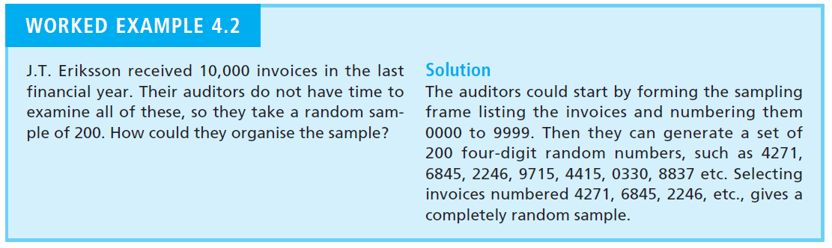

Random Sample
Joseph Marvin R. Imperial
QUANTITATIVE METHODS
NU College of Computing and Information Technologies
Course Code: CCQUAMET

Slide 23
Systematic Sample
One way of organising a non-random sample is to collect data at regular intervals with a systematic sample.
Systematic sampling is not always representative.
Examples:
You might interview every tenth person using a service, weigh every twentieth unit from a production line or count the people in every sixth car passing. This is not a random sample because every member of the population does not have the same chance of being chosen
If you interview every tenth person using a service, then members 11, 12, 13 and so on have no chance of being selected.
Joseph Marvin R. Imperial
QUANTITATIVE METHODS
NU College of Computing and Information Technologies
Course Code: CCQUAMET

Slide 24
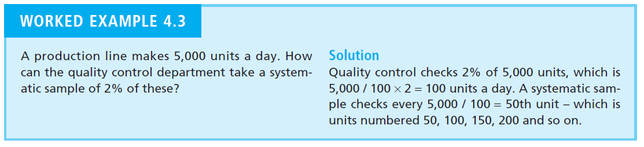
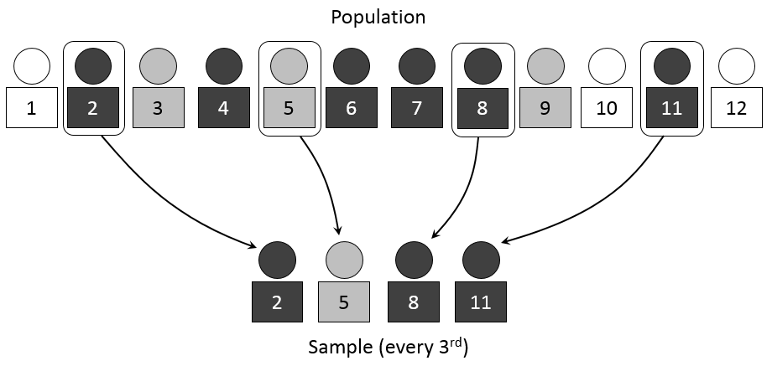
Systematic Sample
Joseph Marvin R. Imperial
QUANTITATIVE METHODS
NU College of Computing and Information Technologies
Course Code: CCQUAMET

Slide 25
Stratified Sample
When there are distinct groups – or strata – in the population, it is a good idea to make sure that members from each stratum are fairly represented in a sample.
To do a stratified sample, (a) you divide the population into strata and (b) then take a random sample from each, with the number chosen from each stratum ensuring that the overall sample contains the right mix.
Example:
60% of people working in a company might be women. To get a stratified sample of views, you divide the population of employees into two strata –women and men – and randomly select 60% of your sample from women and 40% from men.
Joseph Marvin R. Imperial
QUANTITATIVE METHODS
NU College of Computing and Information Technologies
Course Code: CCQUAMET

Slide 26
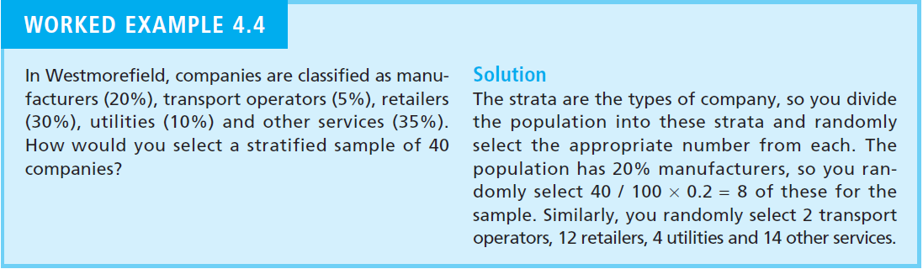
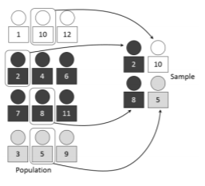
Stratified Sample
Joseph Marvin R. Imperial
QUANTITATIVE METHODS
NU College of Computing and Information Technologies
Course Code: CCQUAMET

Slide 27
Convenience Sample
Convenience sampling is a method of collecting samples by taking samples that are conveniently located around a location or Internet service.
The most common form of non-probabilistic sampling, mostly because it is misused. There is no pattern whatsoever in acquiring these respondents. Often results are non-representative if used in a wrong way.
Example:
Performing convenience sample in a small class of computer science students does not represent the general public very well.
The proper use of convenience sampling would be sampling of craigslist, the Silk Road, or other black market services to study cyber-crime communication. Selecting a set of found communications would adequately represent other criminal communication.
Joseph Marvin R. Imperial
QUANTITATIVE METHODS
NU College of Computing and Information Technologies
Course Code: CCQUAMET

Slide 28
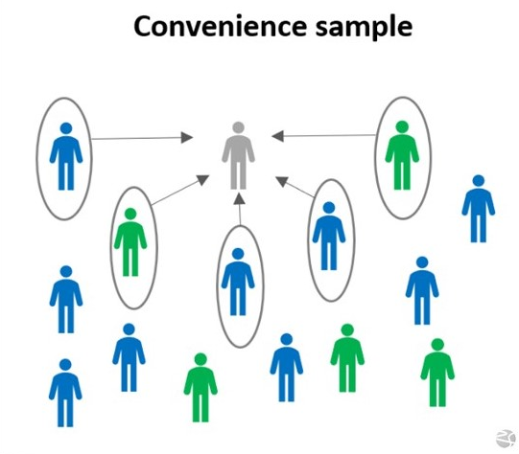
Convenience Sample
Joseph Marvin R. Imperial
QUANTITATIVE METHODS
NU College of Computing and Information Technologies
Course Code: CCQUAMET

Slide 29
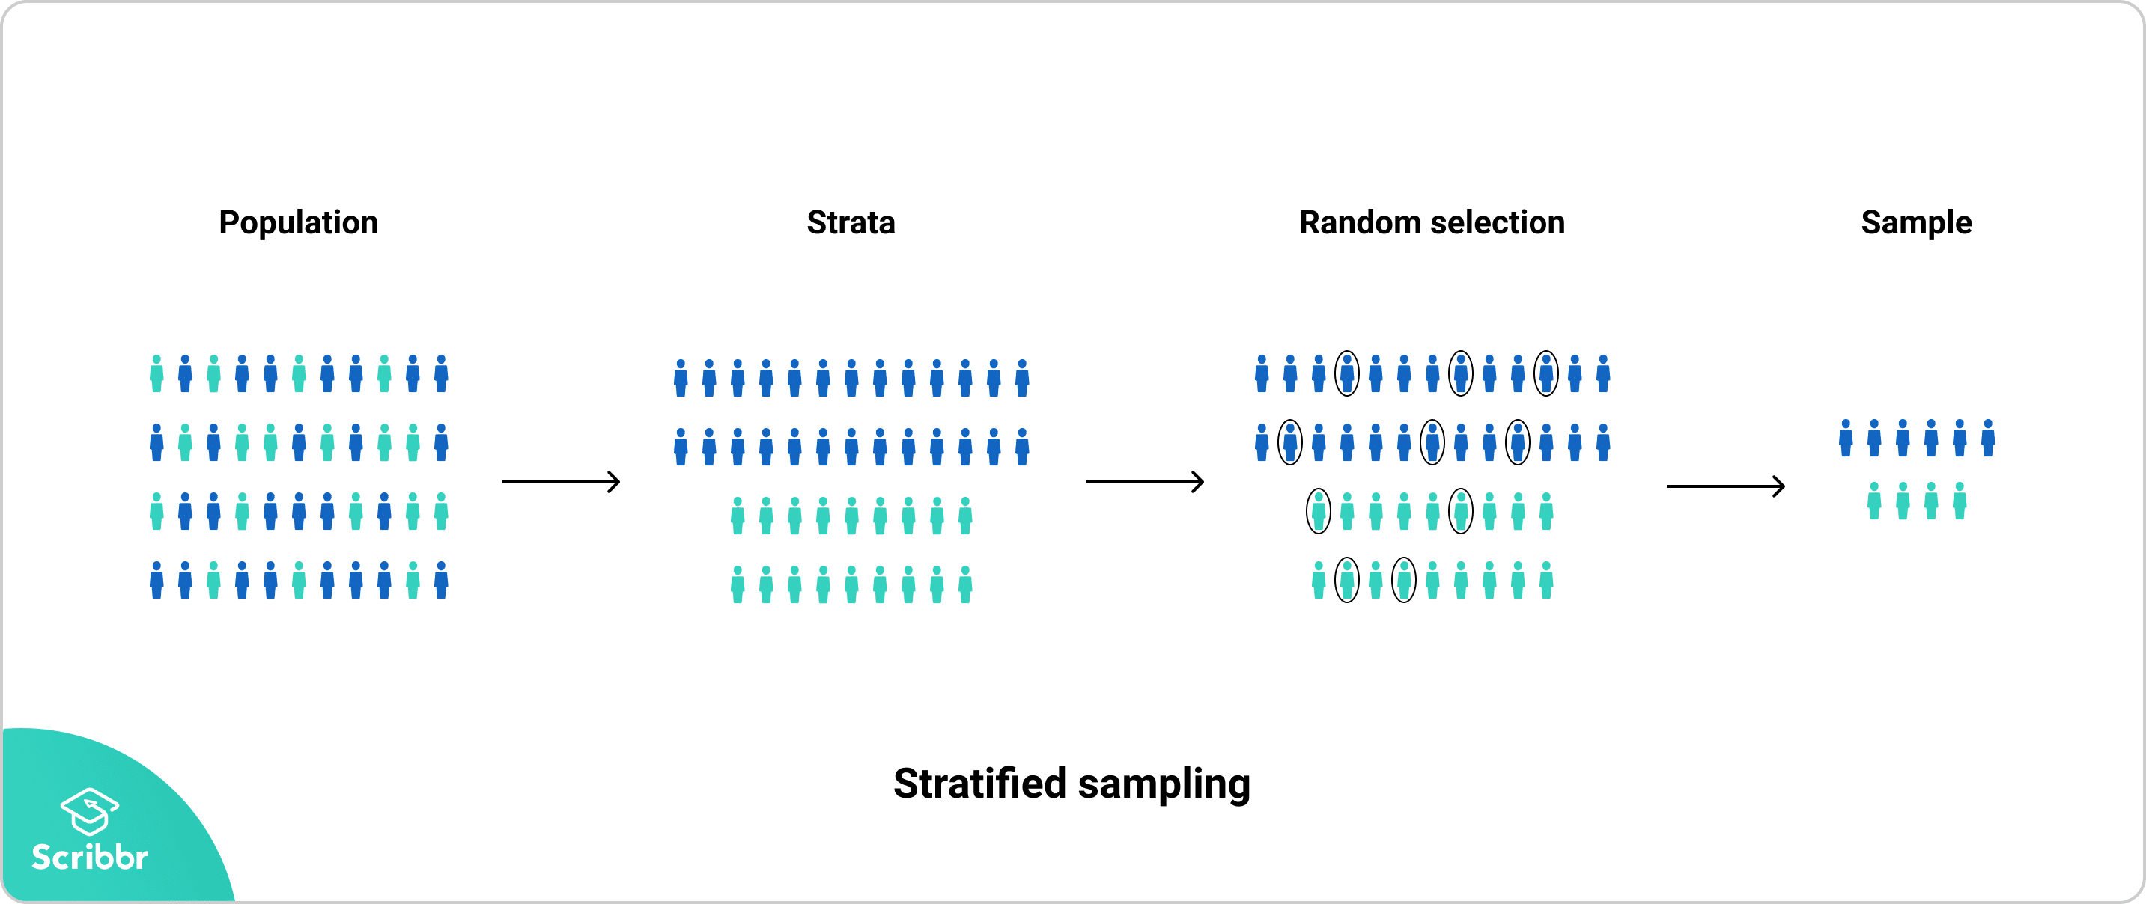
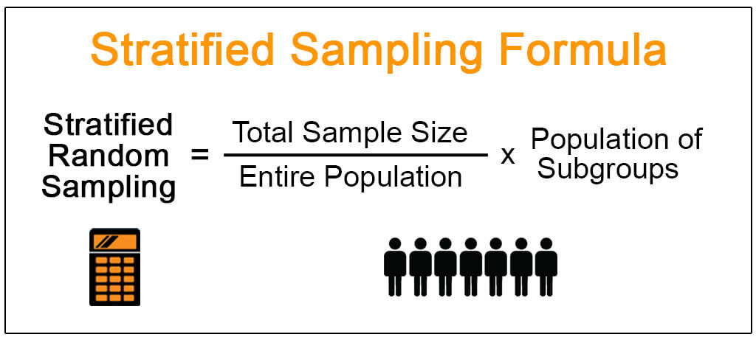
Joseph Marvin R. Imperial
QUANTITATIVE METHODS
NU College of Computing and Information Technologies
Course Code: CCQUAMET

Slide 30
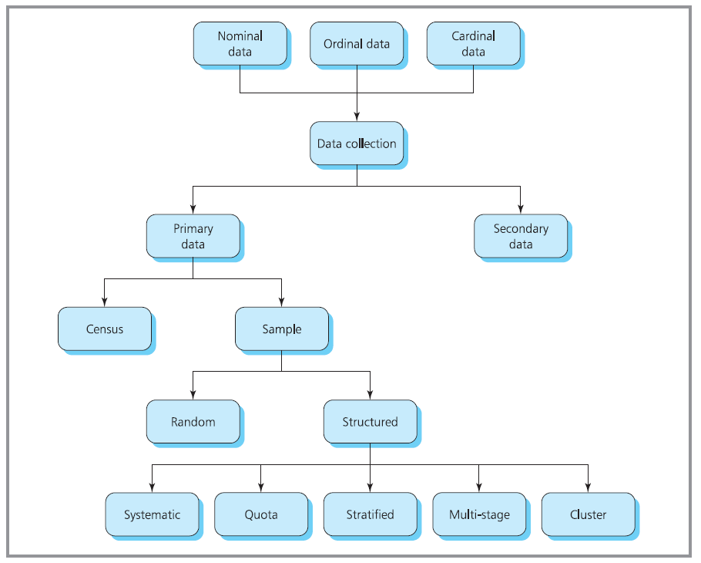
Joseph Marvin R. Imperial
QUANTITATIVE METHODS
NU College of Computing and Information Technologies
Course Code: CCQUAMET

Slide 31
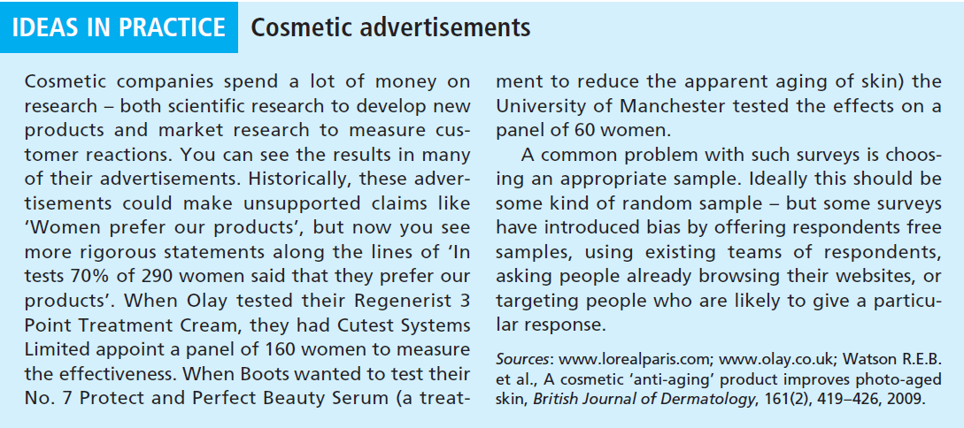
Joseph Marvin R. Imperial
QUANTITATIVE METHODS
NU College of Computing and Information Technologies
Course Code: CCQUAMET

Slide 32
References
https://www.earlyyearsresources.co.uk/images/real-life-numbers-photocards-p30838-2524386_image.jpg
https://cdn.slidesharecdn.com/ss_thumbnails/qualitativevsquantitativedata-infographic-180629141709-thumbnail-4.jpg?cb=1530281874
https://www.google.com.ph/url?sa=i&url=https%3A%2F%2Fmethods.sagepub.com%2Fbook%2Fessentials-of-marketing-research%2Fn3.xml&psig=AOvVaw2UbM0d645lN0F4gOGjFH17&ust=1607588981206000&source=images&cd=vfe&ved=0CAIQjRxqFwoTCKCo6eS9wO0CFQAAAAAdAAAAABAZ
Joseph Marvin R. Imperial
QUANTITATIVE METHODS
NU College of Computing and Information Technologies
Course Code: CCQUAMET

